Slide 1
Sexual Reproduction

Slide 2
Sexual Reproduction
Except the Fungi Imperfecti Deuteromycetes, Fungi reproduce sexually.
There are three distinct stages in sexual reproduction:
Plasmogamy (Gr. Plasma = a molded object + gamos = marriage,union), i.e fusion of cytoplasm of conjugate cells
Karyogamy (Gr. Karyon= nut, nucleus + gamos = marriage, union), i.e fusion of conjugant nuclei
Meiosis (Gr. Meiosis= reduction) i.e a series of two nuclear divisions of the fusion nucleus which usually take place in quick succession. This results in the reduction of the chromosome number to half.

Slide 3
Sexual Reproduction
The sex organs are called gametangia and the sex cells are called gametes.
Inspite of the variety of sexual apparatuses, four basis types have been recognised among the fungi by Kniep(1928) and are examplified in four wellknown representative species (Fig.1.28). Each type comprises of definite groups of fungi.
i). Gametic copulation
ii). Gamete-gametangial copulation
iii). Gametangial copulation
iv). Somatic copulation
v). Spermatization

Slide 4
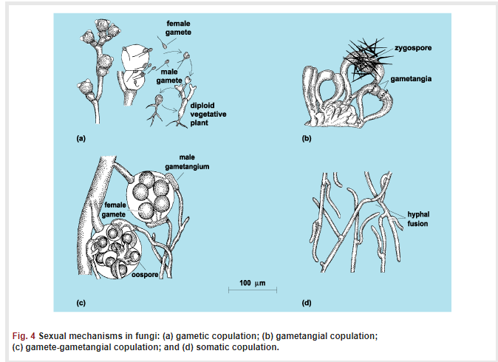
Sexual Reproduction

Slide 5
Sexual Reproduction
i). Gametic copulation in which the two elements brought together in the sexual act comprise uninucleate, free gametes of which one or both may be motile.
ii). Gamete-gametangial copulation- in which one fusing element is a differentiated gamete and the other is a differentiated gametangium which produces no discrete, uninucleate gametes. The differentiated gametes may be either ♂ or ♀ depending upon the group.

Slide 6
Sexual reproduction
iii). Gametangial copulation in which the fusing elements are differentiated as gametangia, one or many pairs of nuclei may be involved, and the two gametangia may even be differentiated as ♂ and ♀ or they may be morphologically indistinguishable.
iv). Somatic copulation in which fusion occurs between undifferenetiated vegetative cells or spores. In mycelial forms, fusion is commonly followed by reciprocal nuclear migration, each mate fertilizing the other, and once brought together, the two compatible nuclei usually retain a dikaryotic association
v). Spermatization union of a special male structure called a spermatizaion with female receptive structure. The spermatium empties its contents into the latter during plasmogamy.

Slide 7
Sexual spores
1. Sexual spore produced by the fusion of two nuclei, occur less frequently, later, and in smaller numbers than do asexual spores.
2. There are several types of sexual spores:
2a. Ascospores.
2b. Basidiospores
2c. Zygospores
2d. Oospores.

Slide 8
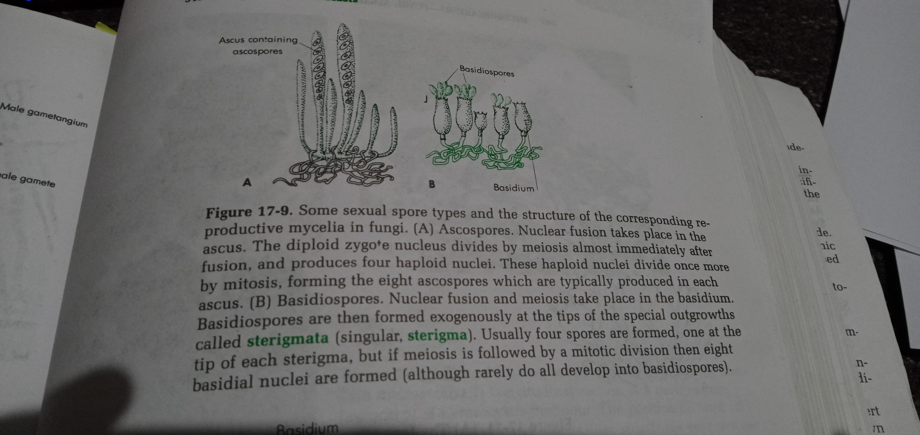
Ascospore

Slide 9
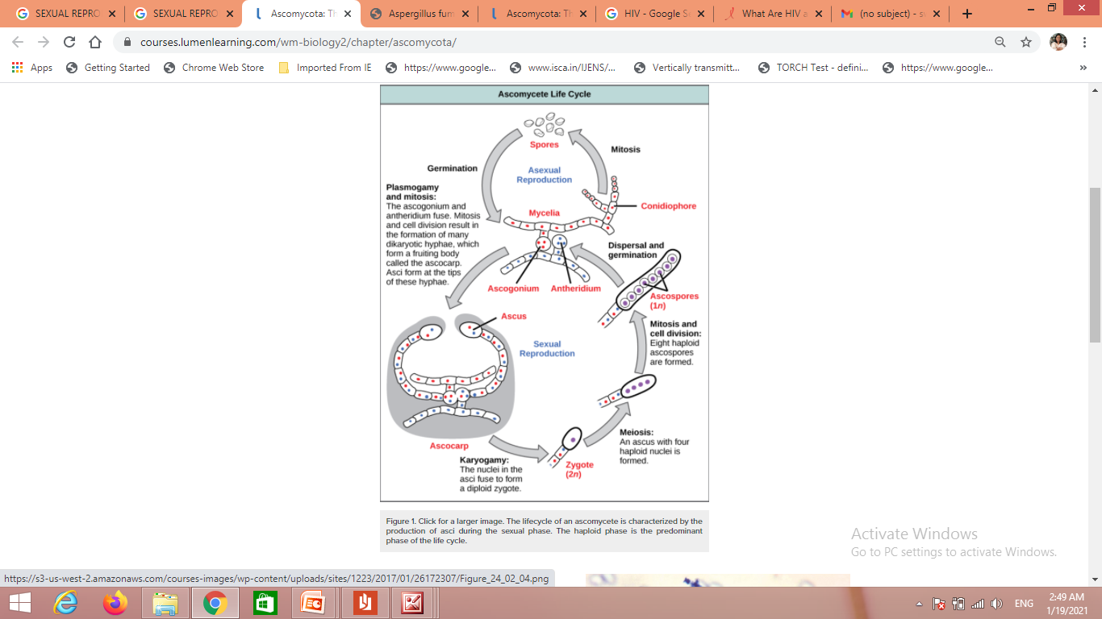
Ascospore

Slide 10
Ascospore
Ascospores are single celled spore are produced in a sac called an ascus (plural, asci).
There are usually eight ascospores in each ascus
Nuclear fusion takes place in the ascus.
The diploid zygote nucleus divides by meiosis almost immediately, after fusion, and produces four haploid cells
These haploid nuclei divide once more by mitosis, forming eight ascospores which are typically produced in each ascus.

Slide 11
The majority of known fungi belong to the Phylum Ascomycota, which is characterized by the formation of an ascus (plural, asci), a sac-like structure that contains haploid ascospores.
Asexual reproduction is frequent and involves the production of conidiophores that release haploid conidiospores. Sexual reproduction starts with the development of special hyphae from either one of two types of mating strains (Figure 1).
The “male” strain produces an antheridium and the “female” strain develops an ascogonium. At fertilization, the antheridium and the ascogonium combine in plasmogamy without nuclear fusion. Special ascogenous hyphae arise, in which pairs of nuclei migrate: one from the “male” strain and one from the “female” strain. In each ascus, two or more haploid ascospores fuse their nuclei in karyogamy.
During sexual reproduction, thousands of asci fill a fruiting body called the ascocarp.

Slide 12
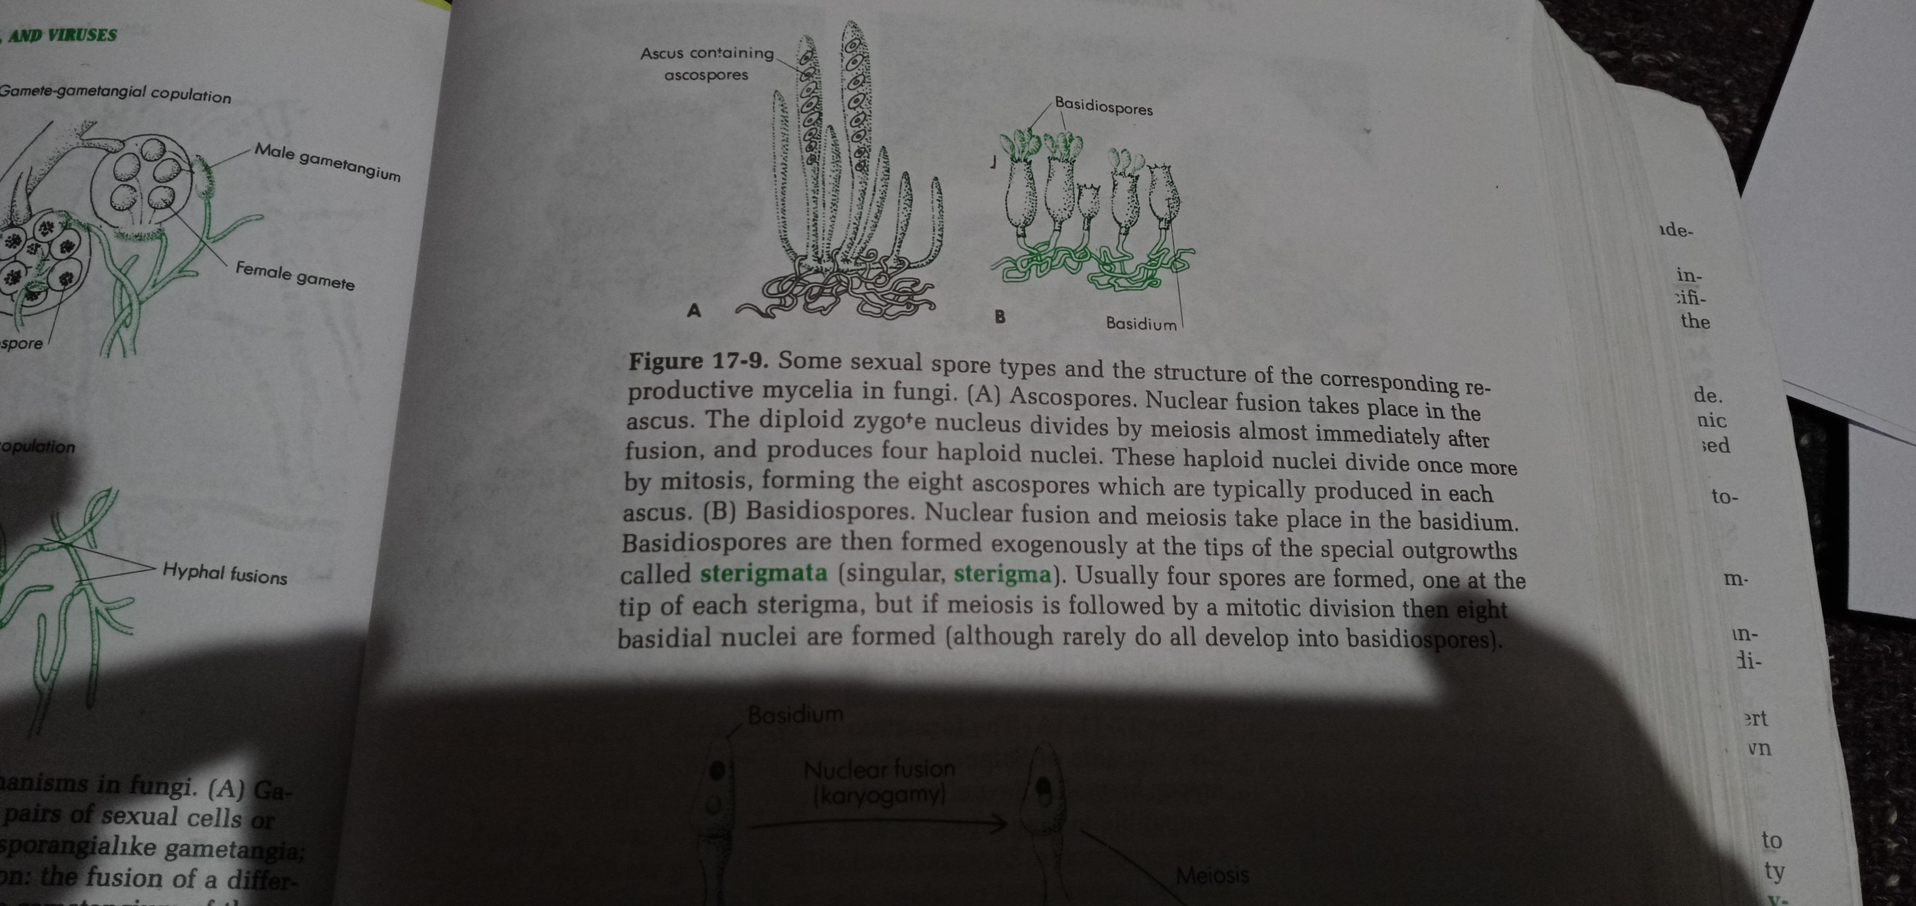
Basidiospore
Basidiospores – these single celled spores are borne on a club-shaped structure called a Basidium (plural, basidia)

Slide 13
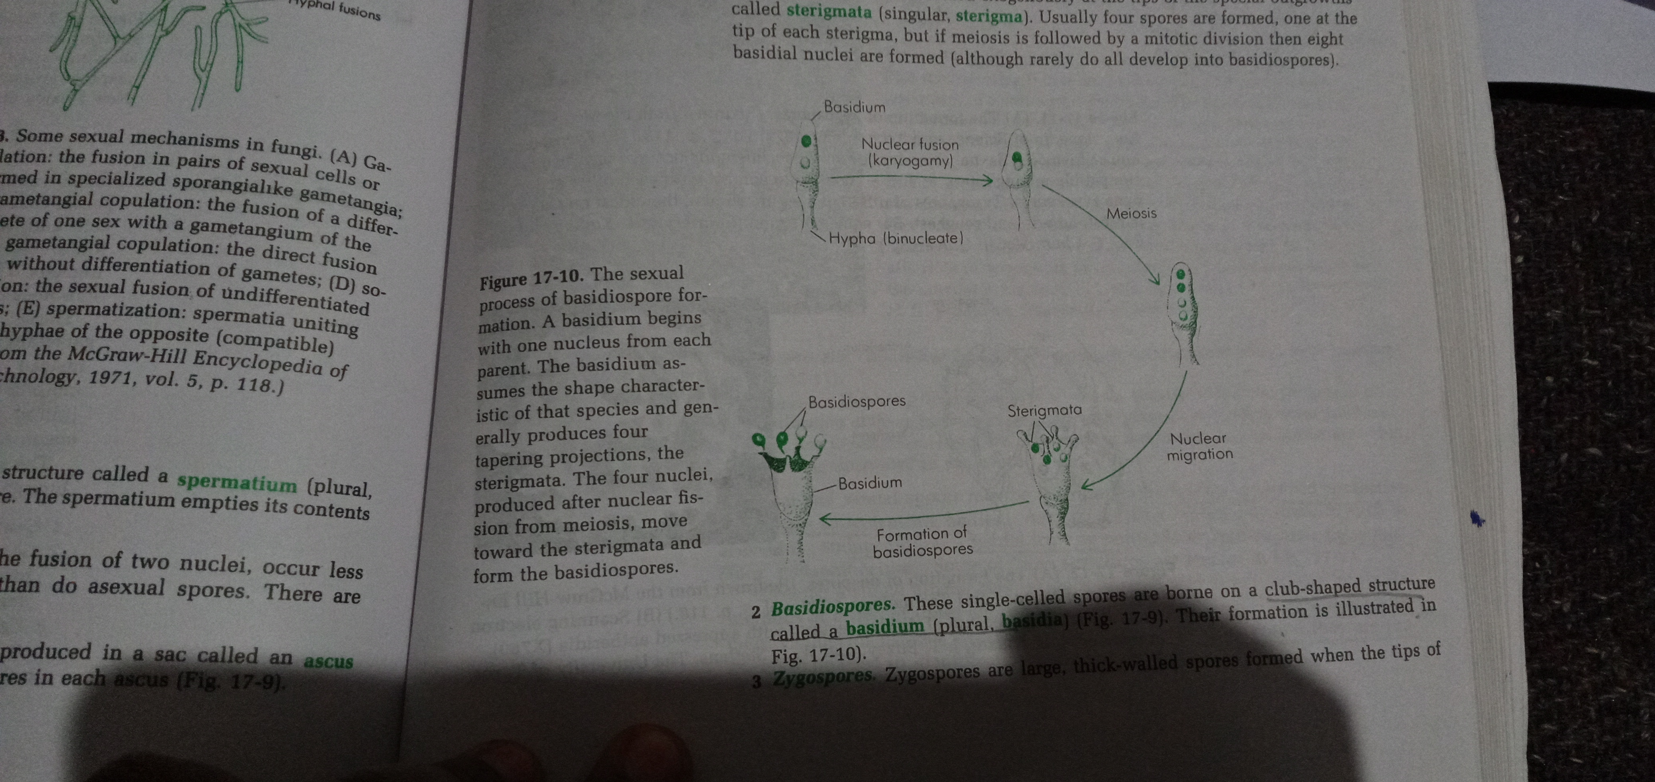
Sexual process of basidiospore formation

Slide 14
Sexual process of basidiospore formation
Nuclear fusion and meiosis take place in the basidium. A basdium begins with one nucleus from each parent.
The basidium assumes the shape characteristic of thatspecies and generally produces four tapering projections, the sterigmata.
The four nuclei, produced after nuclear fission from meiosis, move towards the sterigmata and form the basidiospores.

Slide 15
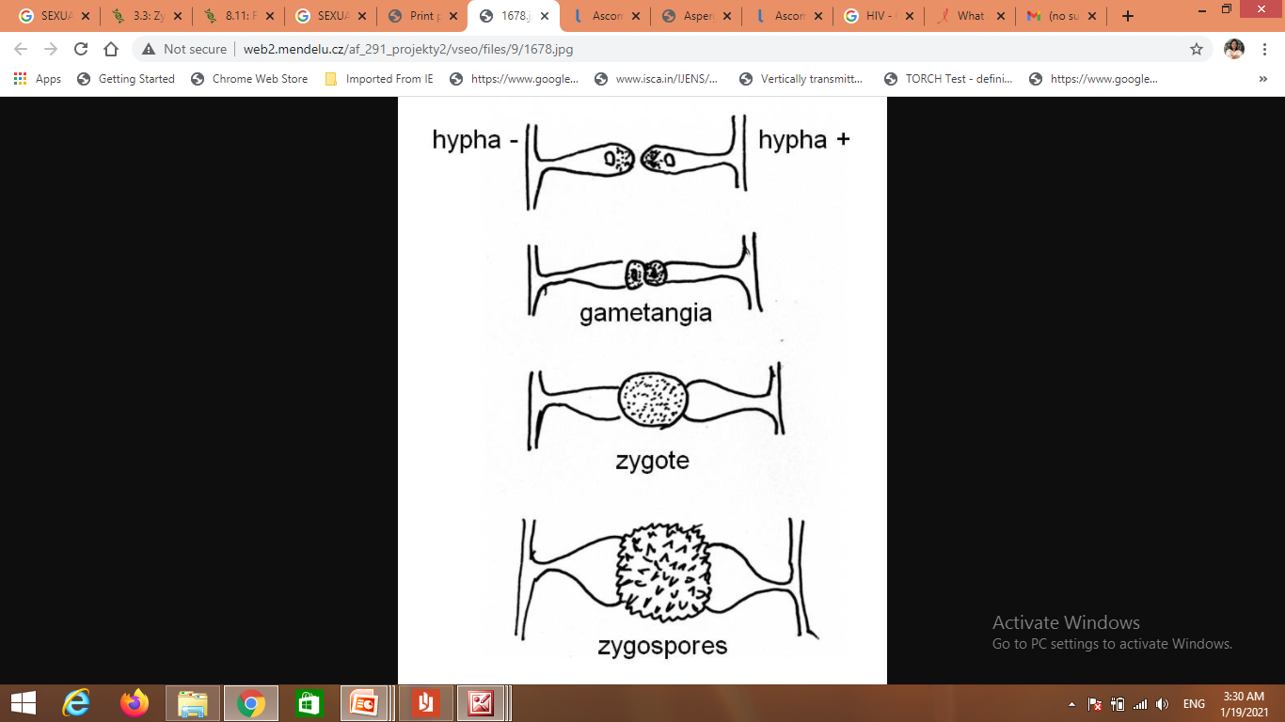
Zygospore
Zygospore are large, thick walled spores formed when tips of two sexually compatible hyphae, or gametangia, of certain fungi fuse together.

Slide 16
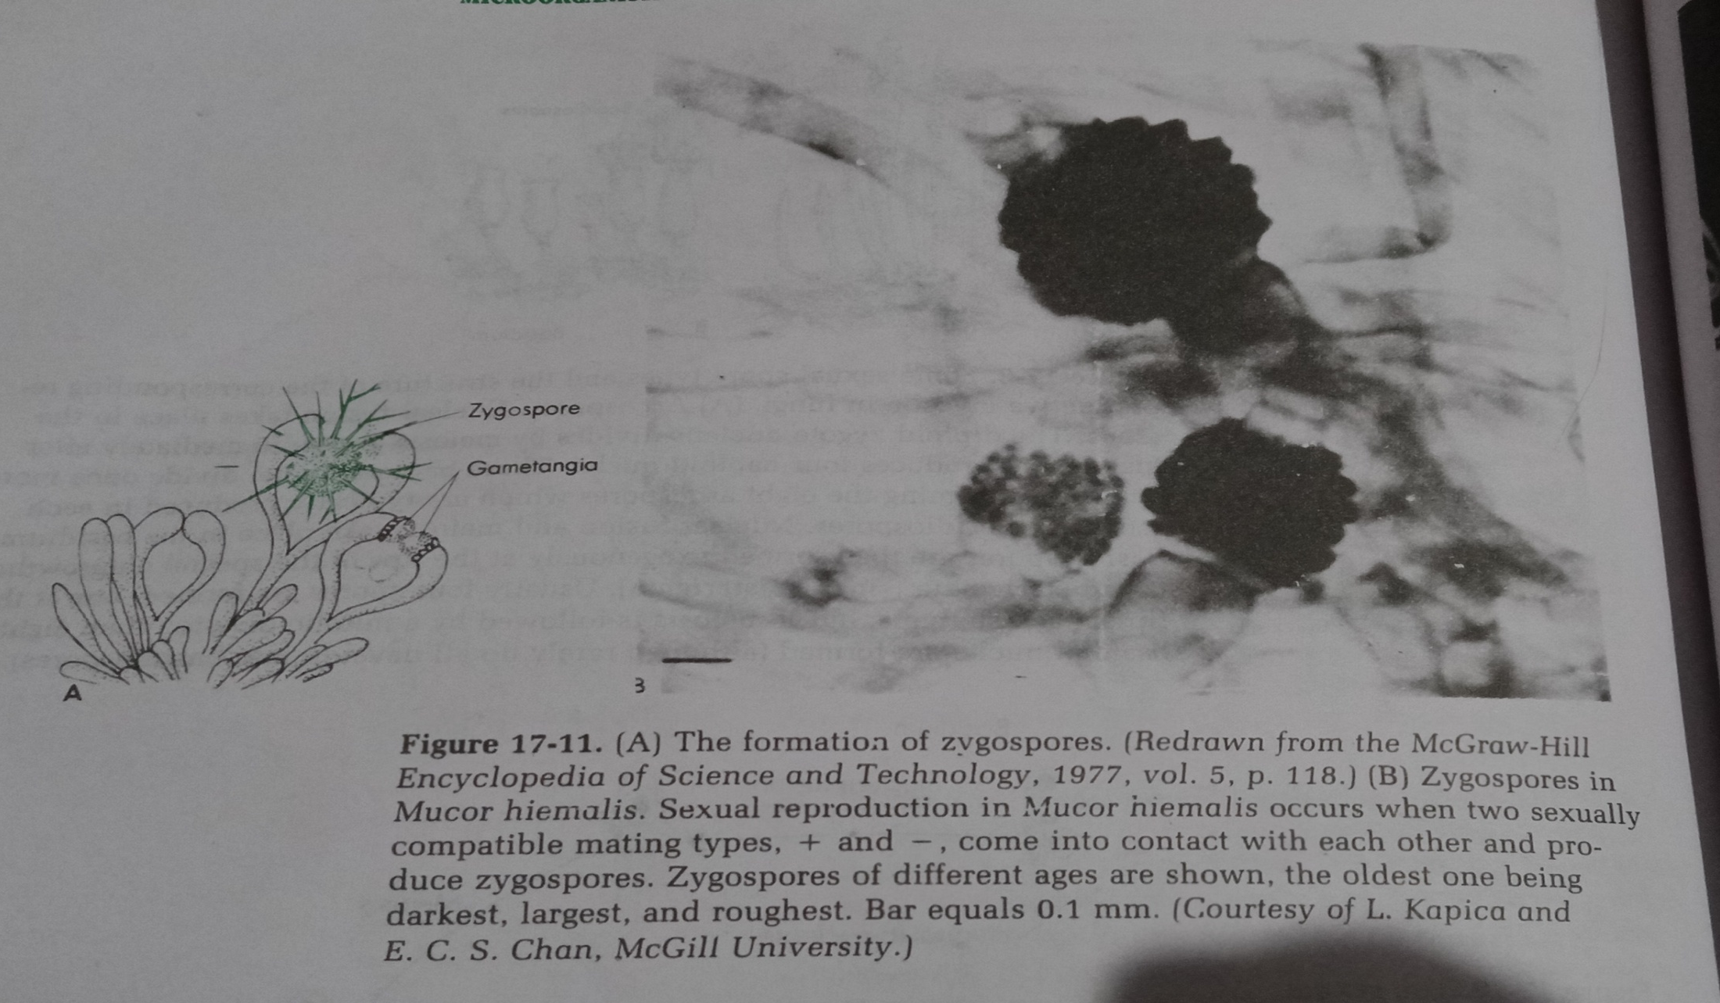
Zygospore

Slide 17
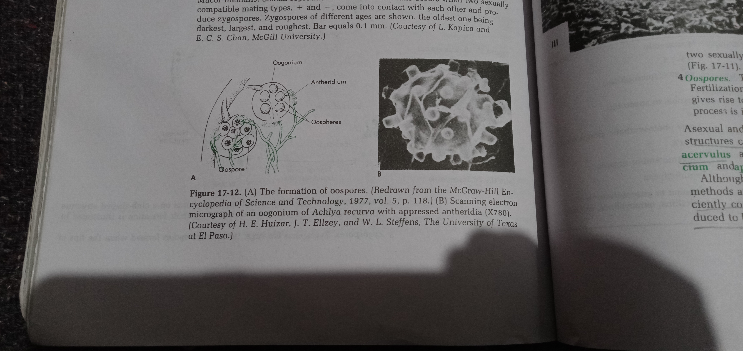
Oospores

Slide 18
Oospores
These are formed within a special female structure, the oogonium.
Fertilization of the eggs, or oospheres, by male gametes formed in an antheridium gives rise to oospores. There are one or more oospheres in each oogonium.

Slide 19
Sexual reproduction in lower fungi
Sexual reproduction in lower fungi in several ways
fusion of motile gametes, isogamous or anisogamous or heterogamous, the zygote being motile for persistent flagella.
Copulation of thalli or parts of thalli.
Fertilization of an oospore i.e. a large, nonmotile female gamete, enclosed within an oogonium by a motile male gamete which enters through a pore in the oogonium wall to yield oospore.
Fertilization of an oosphere by the contents of an antheridium which enters the oogonium through a fertilization tube.
Copulation of gametangia which may be either or equal or unequal in size to give a typical zygospore.
Whatever the case may be, plasmogamy is almost immediately followed by karyogamy in many simpler fungi
Lower fungi- a fungus with hyphae absent
Isogamous- fusion of gametes of similar shape and size are isogamy, found in unicelluar organisms are isogamous .
Anisogamous or heterogamous- form of sexual reproduction that involve s the union or fusion of two gametes , which differ in size and or form

Slide 20
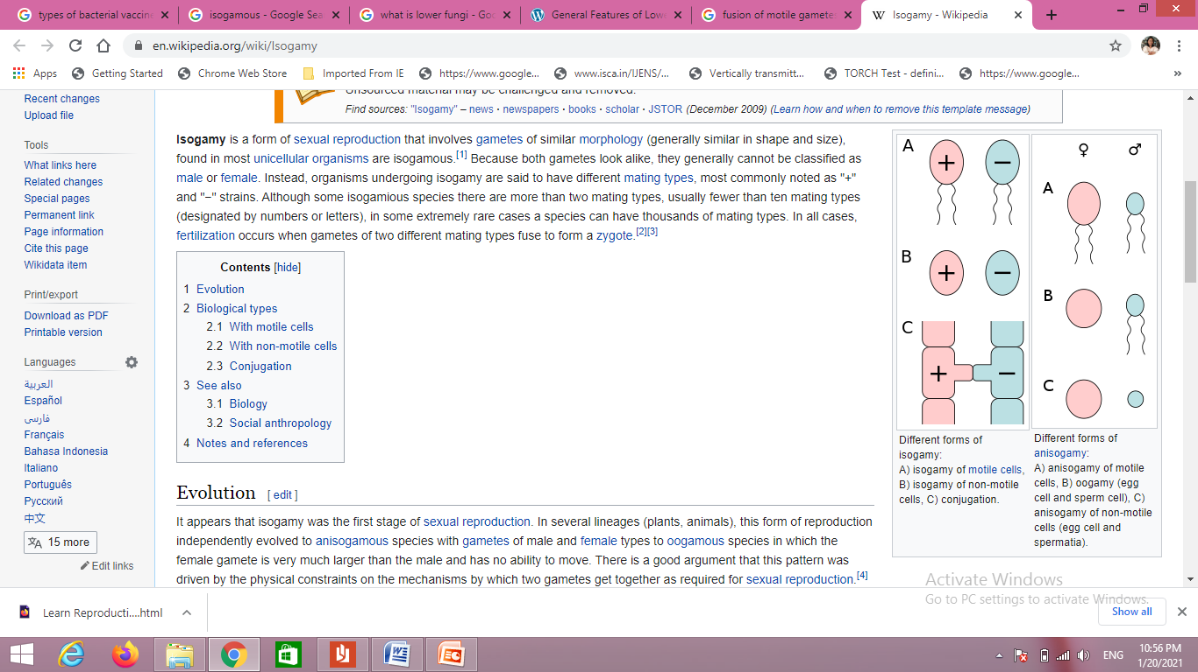
Sexual reproduction in lower fungi in several ways

Slide 21
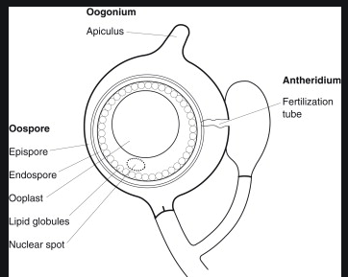

Slide 22
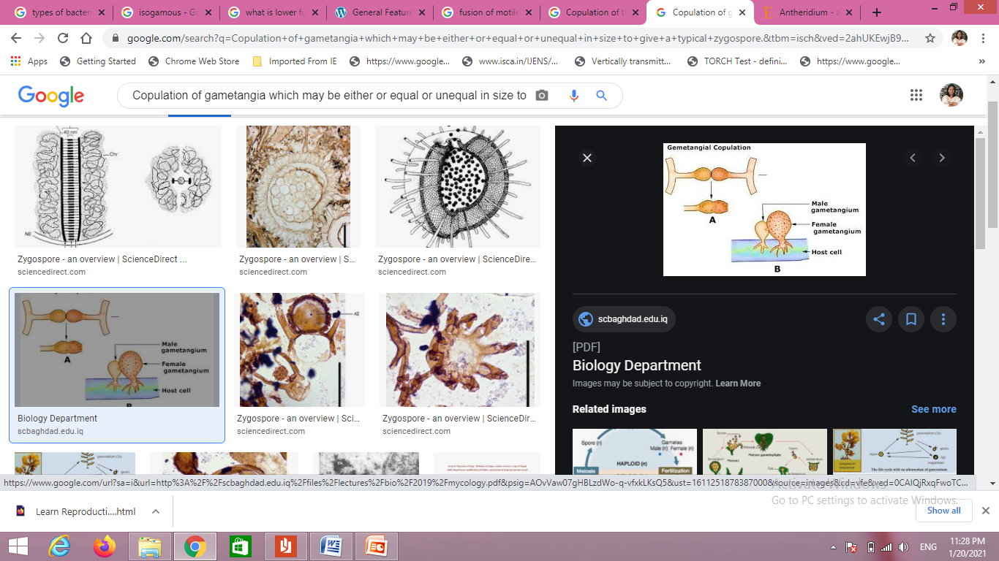

Slide 23
Sexual Compatibility in fungi
Obligatory inbreeding and outbreeding also occurs in fungi as in many highly evolved plants and animals. On the basis of sex, most fungi may be classsified into three categories:
Hermaphroditic or Monoecious in which each thallus bears both male and female organs that may or may not be compatible.
Dioecious in which some thalli bear only male and others bear female organs
Sexually undifferentiated, in which sexually functional structures are produced that are morphologically indistinguishable as male or female.

